Slide 1
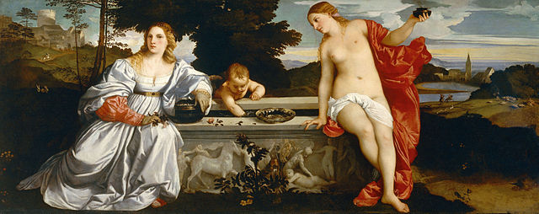
History 336
Ideas and Society in Early Modern Europe:
The Debate about Gender and Identity

Slide 2
Questions for 27 March
What passages strike you as historically significant in the assigned reading from Poullain?
What is the central message of Poullain’s Excellence of Men? What strategies does he employ to convey that message? Do the message and strategies of this work reflect the message and strategies of the two other works by Poullain that we have read? How do the message and strategies of the Excellence of Men compare with the other primary sources that we have read?

Slide 3
Questions for 27 March
A hermeneutic is a principle of interpretation. What would you call or how would you describe Poullain’s hermeneutic for reading biblical passages about men and women? Consider pp. 268-75, 282-88, and 294-301.
Remember what Joan Scott says about gender: “gender is a primary way of signifying relationships of power.” How can we apply this idea to the discussion of dominion (pp. 275-81) and the discourse on women’s facility for love (pp. 305-14)?

Slide 4
Questions to consider for the rest of the course
What passages strike you as historically significant? Mark them and write them down.
What positions on women and gender does a given primary source take on women and gender? How does the author support these positions?
Can you formulate at least one historical question based on the assigned reading to start a larger discussion?
Can you find a few secondary sources (and other primary sources) by using the library catalogue and databases that will help you answer your historical question?
Can you think of any current news stories that relate to women and gender?

